Slide 1
The VM: Stack Arithmetic
project 5
Yana Gabelev

Slide 2
Links
Project 4:
http://my.jce.ac.il/~arikgi/Web/Ex/Ex05/index.htm
EX03 zip :
http://my.jce.ac.il/~arikgi/Web/Ex/Ex05/Ex05.zip

Slide 3
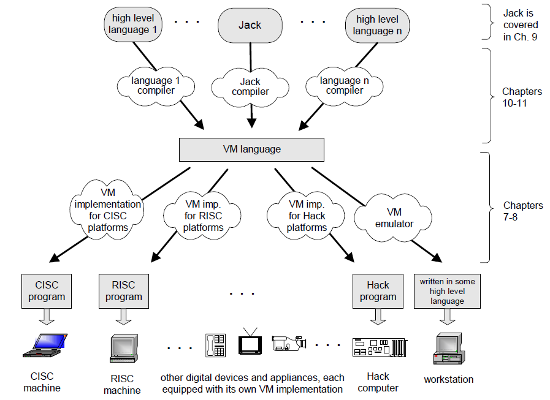
Notes:
קוד הביניים – הממשק בין 2 שלבי הקומפילציה.
המעבר הזה תלוי ב 2 דברים – שפת הקוד, והפלטפורמה.
הפיצול ל 2 שלבים נותן לנו מסגרת אחידה לכל השפות והמחשבים
עבור n שפות ו-m מחשבים: במקום ליצור n*m טרנסלטורים (כל שפה מתורגמת לכל מכונה בנפרד) יווצרו רק n+m טרנסלטורים (כל שפה מתורגמת לVM ומVM נתרגם לכל מכונה)

Slide 4
Stack Machine Model
A stack is an abstract data structure that supports two basic operations: push and pop.
The stack implements a last-in-first-out (LIFO) storage model.
Arithmetic commands pop their operands from the top of the stack and push their results back onto the top of the stack.
Other commands transfer data items from the stack's top to designated memory locations, and vice versa.

Slide 5
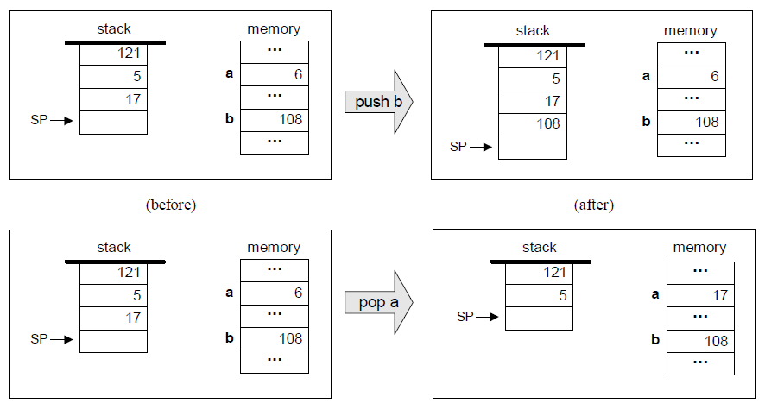
Example:

Slide 6
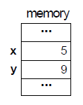
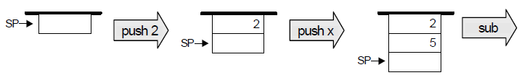
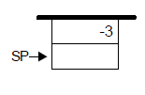
Stack Arithmetic
The two top elements are popped from the stack, the required operation is performed on them, and the result is pushed back onto the stack.
push 2
push x
sub
2-x

Slide 7
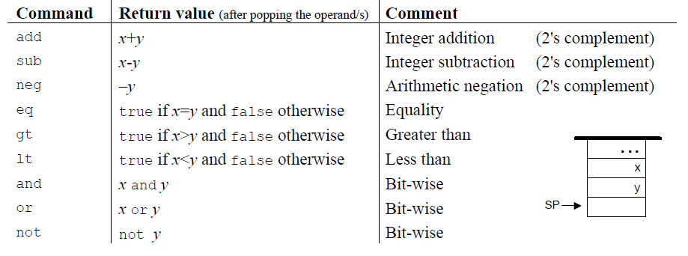
Arithmetic and logical commands
VM language features 9 stack-oriented arithmetic and logical commands:
7 binary commands: pop 2 items off the stack, compute a binary function on them, and push the result back onto the stack.
2 unary commands: pop 1 item off the stack, compute a unary function on it, and push the result back onto the stack.

Slide 8
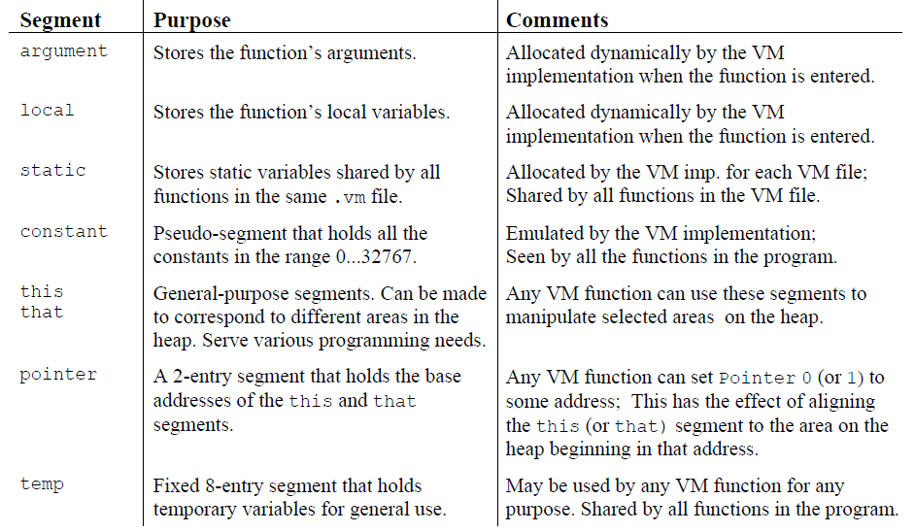
Memory Access Commands
VM manipulates eight separate virtual memory segments:

Slide 9
Push/Pop Commands
Push command changes stack size in +1, while pop command is -1.
local i = RAM[ RAM[LCL] +i ]
argument i = RAM[ RAM[ARG] +i]
this i = RAM[ RAM[THIS] +i]
that i = RAM[ RAM[THAT] +i]
temp i = RAM[5 +i]
pointer i = RAM[3 +i]
constant i = i
static i (assume file name is File.asm) = @File.i

Slide 10
RAM Address
0-15 | 16 virtual registers
15-255 | Static variables
156-2047 | Stack
2048-16483 | Heap (objects and arrays)
16384-24575 | Memory mapped I/O
Host RAM
Register | Name
RAM[0] | SP | Stack pointer- points to the next topmost location in the stack
RAM[1] | LCL | Points to the base of the current VM function’s local segment.
RAM[2] | ARG | Points to the base of the current VM function’s argument segment.
RAM[3] | THIS | Points to the base of the current this segment.
RAM[4] | THAT | Points to the base of the current that segment.
RAM[5-12] | TEMP | Holds the contents of temp segment
RAM[13-15] |  | General-purpose registers (used by VM)
Notes:
הזיכרון מחולק ל8 סגמנטים (מקטעים) –
סטטי – משותף לכל מחלקה בנפרד
Arg,local,this,that,pointer – לכל instance של פונקציה בנפרד
Temp - סגמנט משותף לכל הקבצים
Constant - סגמנט דמה – משותף לכל הקבצים
איך זה עובד באמת?
Local i = RAM[RAM[LCL]+i] – הערך של LCL פלוס האינדקס המבוקש
כנ"ל עבור ARG THIS THAT
STATIC נמצא בתוך קובץ, לכן נשרשר אותו
Temp i = RAM[5+i]
Pointer i = RAM[3+i]

Slide 11
All the memory segments are managed by the same 2 commands:
push the value of segment[index] onto the stack
pop the topmost stack item and store its value in segment[index]
Example:
push segment i
pop segment i
@2
D=A
@SP
A=M
M=D
@SP
M=M+1
push constant 2
push command
Notes:
איך נממש פעולת pop?
@SP; AM=M-1; D=M

Slide 12
Twist
Add the following commands/features:
mult2 = 2x (unary operation)
push/pop nothing n - push/pop n spaces (dont care what) to/from the stack
push/pop temp n - should produce an error if n is greater or equal to 8

Slide 13
Proposed Implementation Stages
Stage I: Implement the nine stack arithmetic and logical commands of the VM language as well as the “push constant x” command (which will help testing the nine former commands).
Stage II: Include a full implementation of the VM language's push and pop commands, handling all eight memory segments. We suggest breaking this stage into the following sub-stages:
You have already handled the constant segment;
Handle the segments local, argument, this, and that;
Handle the pointer and temp segments.

Slide 14
Implementation
Input is a file name of the form Xxx.vm or a directory name containing one or more .vm files. The result of the translation is always a single assembly language file named Xxx.asm, created in the same directory as the input Xxx.
We propose implementing the VM translator using a main program and two modules:
parser
code writer

Slide 15
Main Program
The main program should construct a Parser to parse the VM input file and a CodeWriter to generate code into the corresponding output file.
It should then march through the VM commands in the input file, and generate assembly code for each one of them.
If the program’s argument is a directory name rather than a file name, the main program should process all the .vm files in this directory. In doing so, it should use a separate Parser for handling each input file and a single CodeWriter for handling the output.

Slide 16
The Parser Module
Handle the parsing of a single .vm file, and encapsulates access to the input code.
It reads VM commands, parses them, and provides convenient access to their components.
In addition, it removes all white space and comments.

Slide 17
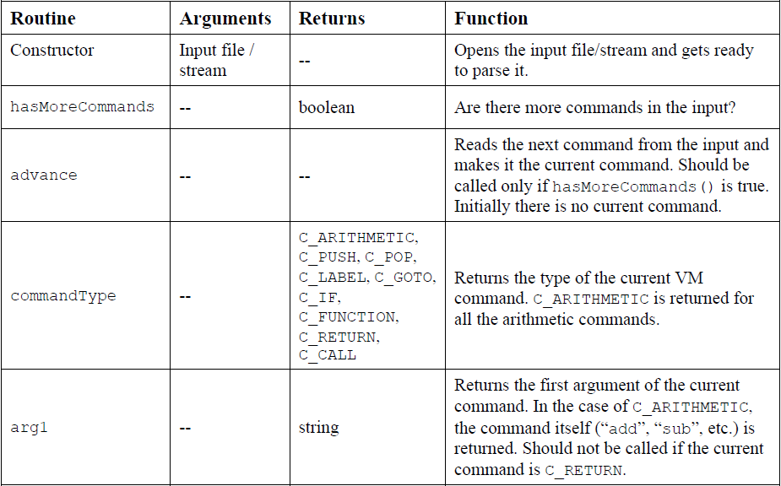
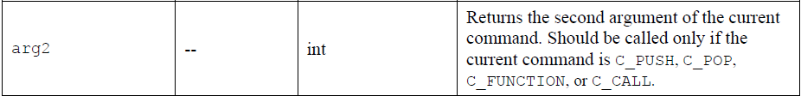

Slide 18
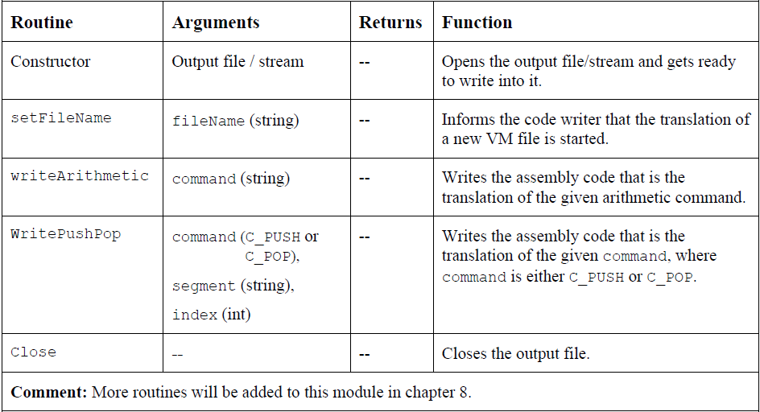
The CodeWriter Module
Translates VM commands into Hack assembly code.

Slide 19
Test Programs
For each one of the five test programs, follow these steps:
Run the Xxx.vm program on the supplied VM Emulator, using the XxxVME.tst test script, to get acquainted with the intended program's behavior.
Use your partial translator to translate the .vm file. The result should be a text file containing a translated .asm program, written in the Hack assembly language.
Inspect the translated .asm program. If there are visible syntax (or any other) errors, debug and fix your translator.
Use the supplied .tst and .cmp files to run your translated .asm program on the CPU Emulator. If there are run-time errors, debug and fix your translator.

Slide 20
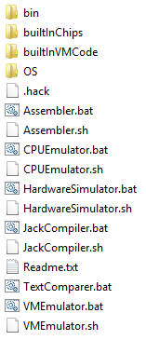
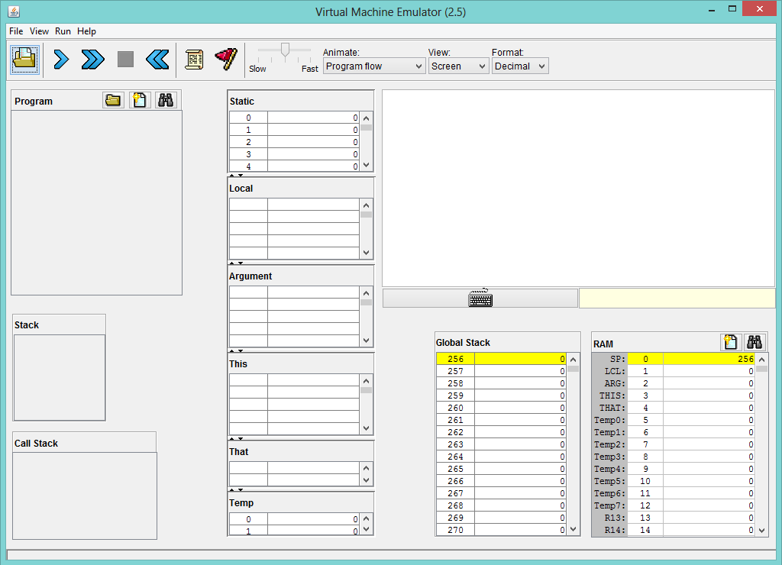
Load XxxVME.tst
Load Xxx.vm

Slide 21
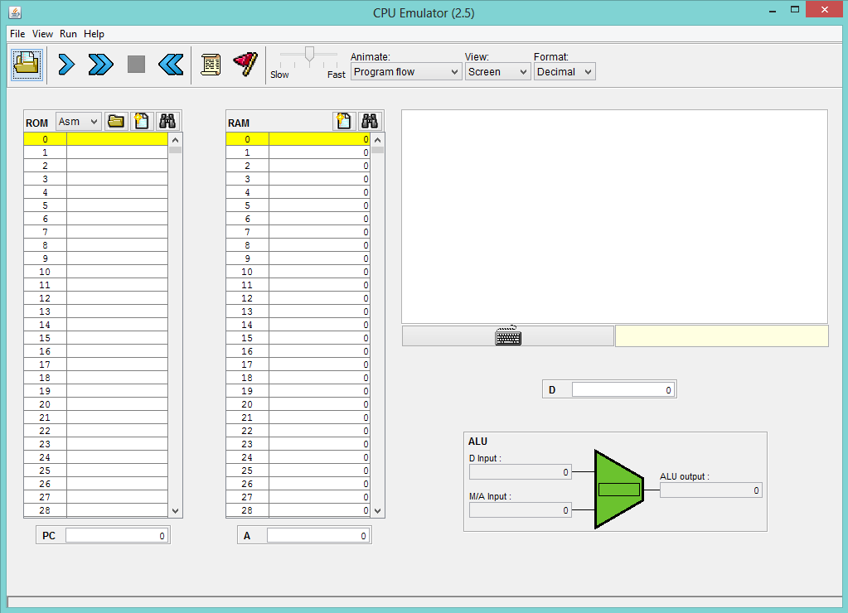
Load Xxx.tst
Load Xxx.asm

Slide 22
How and what to submit
Create a folder named 2015B_exXX_YYYYYYYY, when XX is the ex number, and YYYYYYYY is your ID.
For example: 2015B_ex05_123456789
All submission files should be in that folder, and no other extra file. Files to submit: source files, README.txt
Zip the folder to a zip file named 2015B_exXX_YYYYYYYY.zip

